Slide 1

Parivartan
Automation
Centralized Maintenance
Management System
Insight CMMS

Slide 2
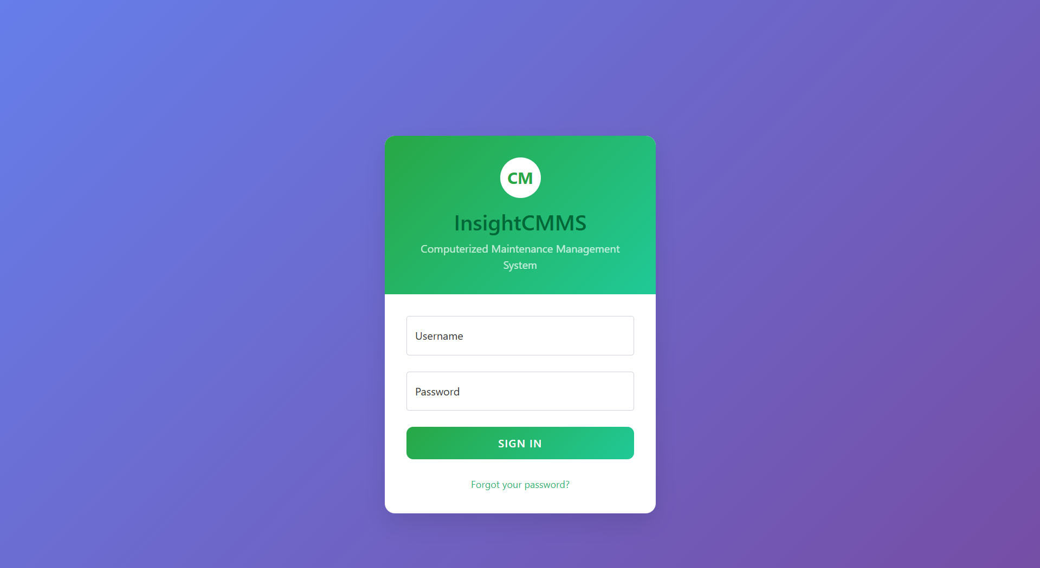
Role
Based
Access

Slide 3
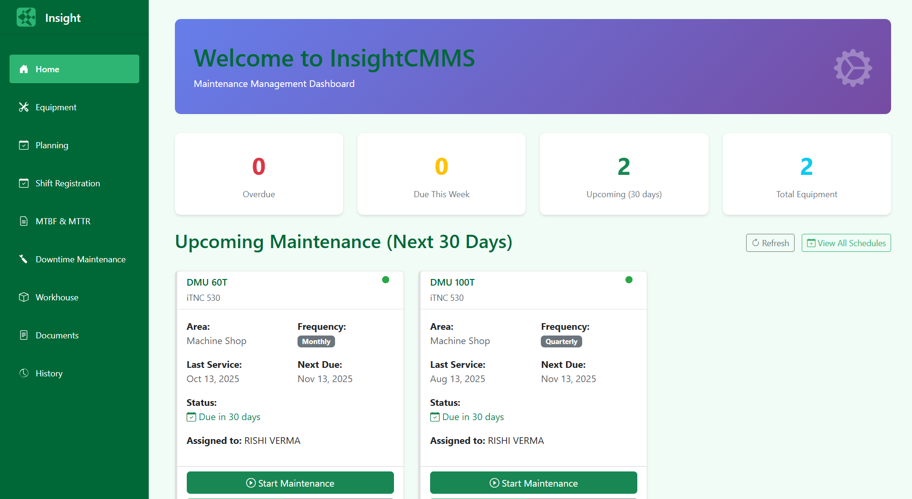
Track
Upcoming
Maintenance

Slide 4
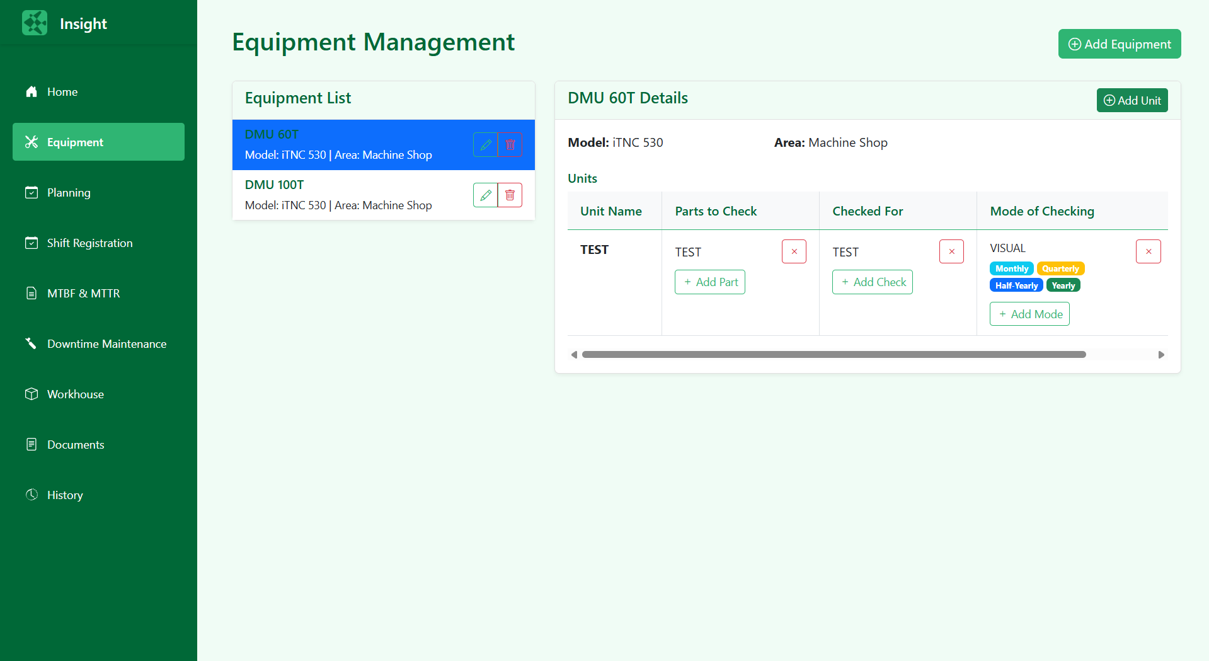
Manage
Equipment
& Checks

Slide 5
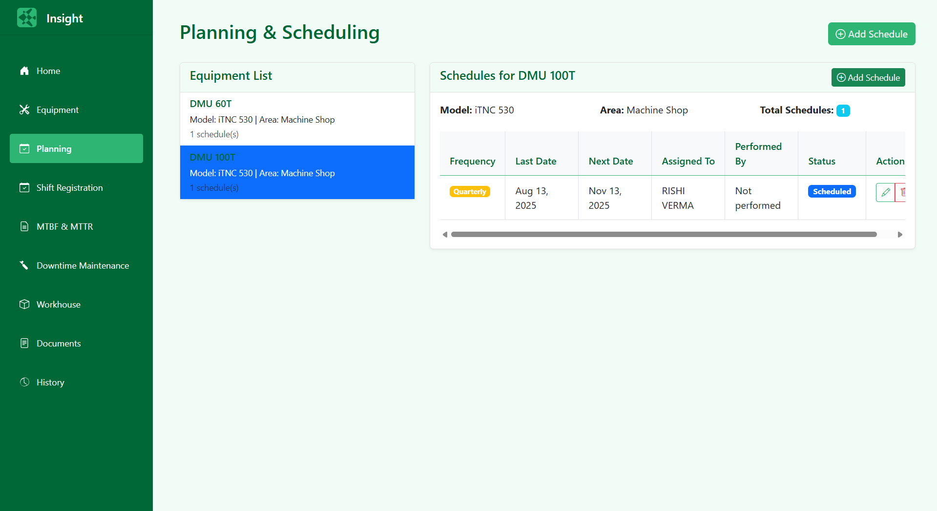
Automate
Maintenance
Planning

Slide 6
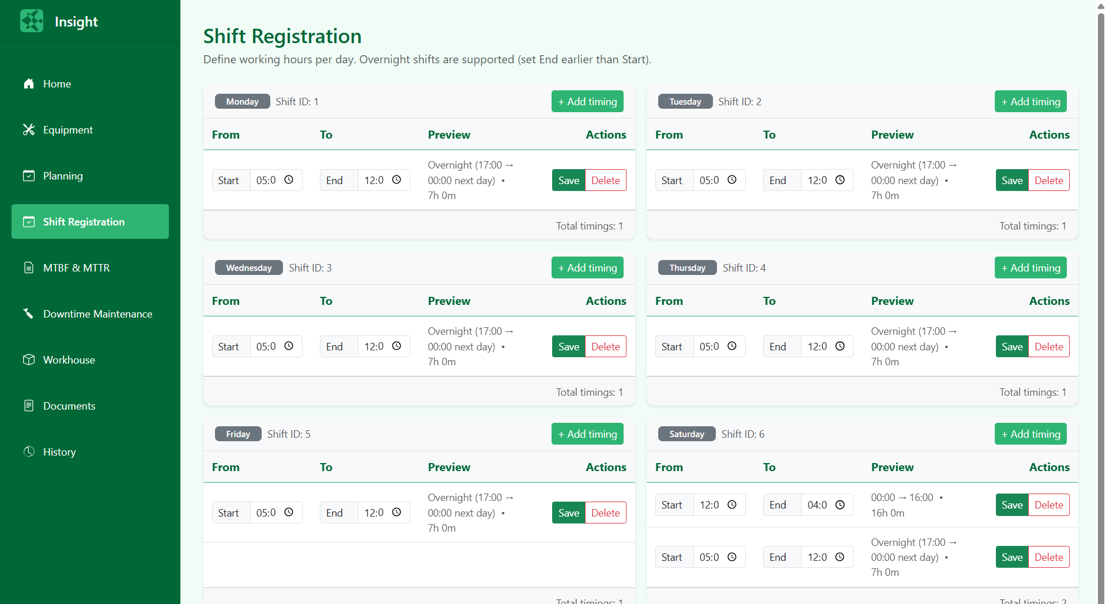
Define
Weekly
Work Hours

Slide 7
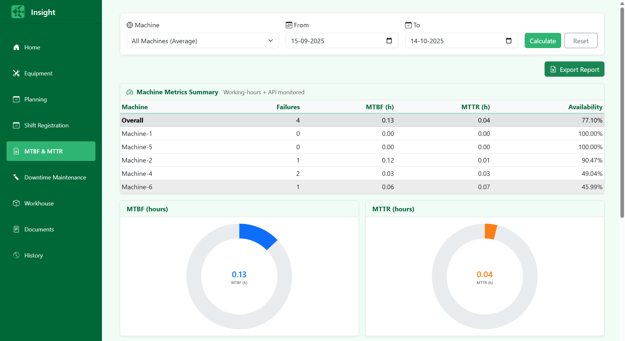
Analyze
Reliability
Metrics

Slide 8
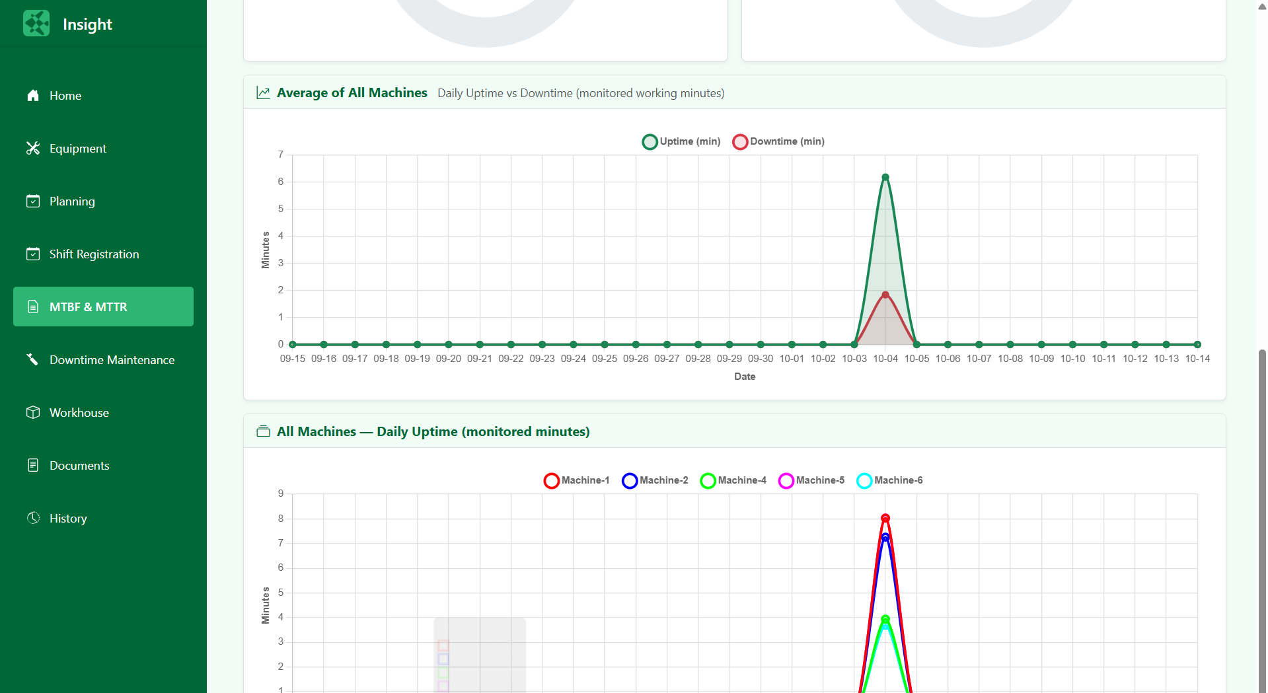
Analyze
Reliability
Metrics

Slide 9
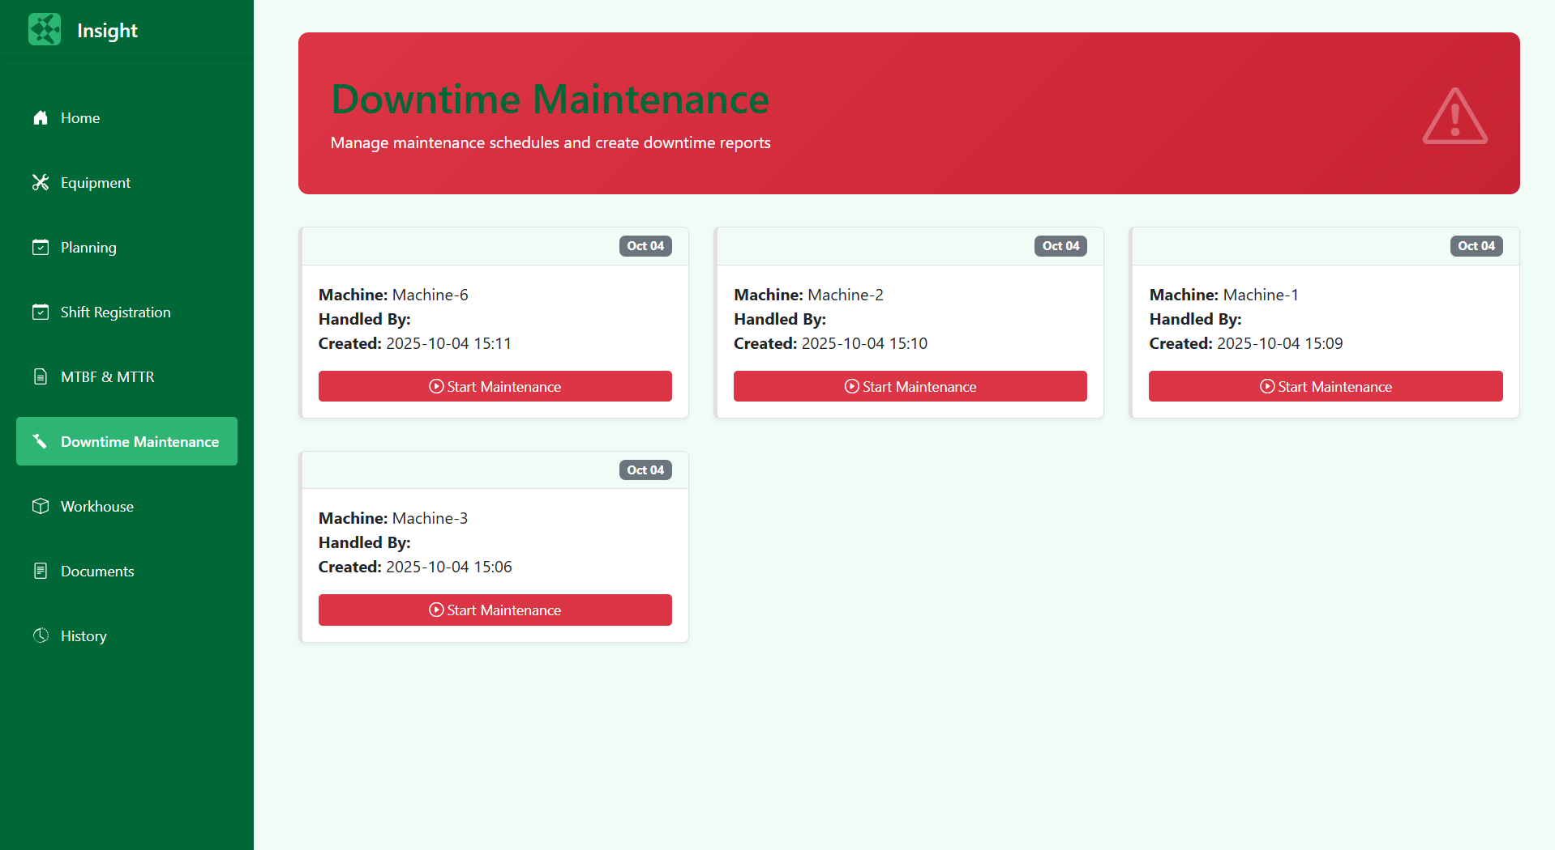
Monitor
& Manage
Downtimes

Slide 10
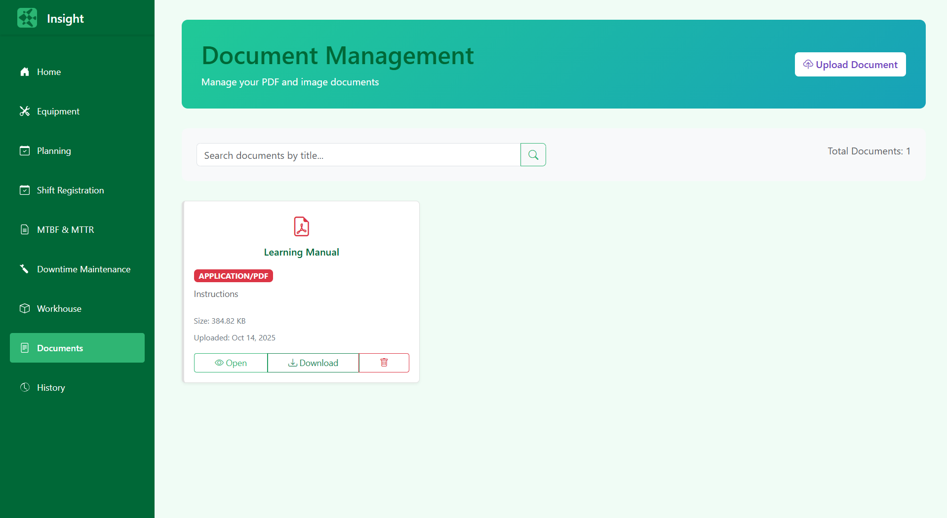
Store
& Access
Manuals

Slide 11
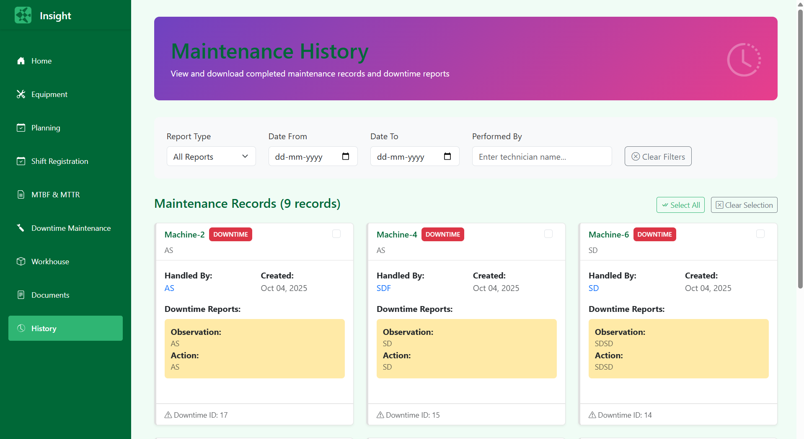
Review
Past
Maintenance
Records

Slide 12
Thank you
Kamala Prasad
+91 8318768865
kpverma@parivartanautomation.com
www.parivartanautomation.com

